Slide 1
2 Thessalonians 1:1-10

Slide 2
47 verses
Writes 1 Thessalonians
Writes 2 Thessalonians
AD 51
AD 52
Visits Thessalonica
2 Thessalonians 1:1-10

Slide 3
2 Thessalonians 1:1-10

Slide 4
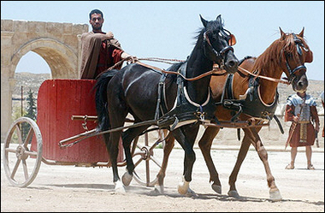
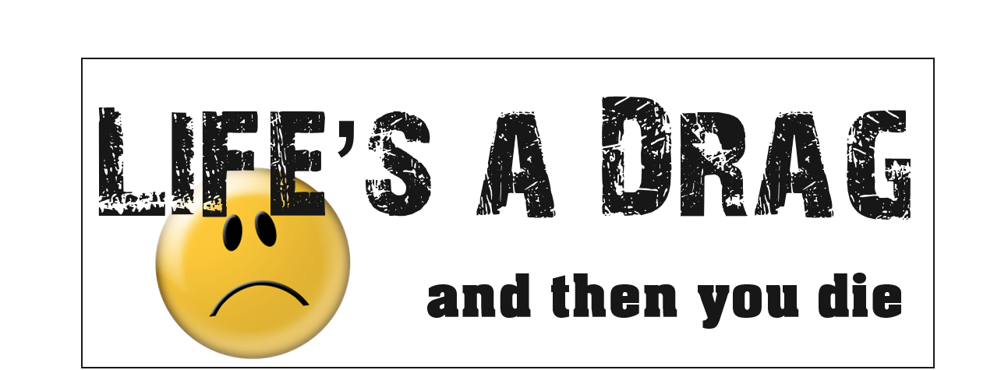
2 Thessalonians 1:1-10
This Photo by Unknown Author is licensed under CC BY-NC-SA

Slide 5
2 Thessalonians 1:1-10

Slide 6
bound ~ ophellō – to incur a debt
1 Thess. 1:3 ~ remembering without ceasing your work of faith, labor of love, and patience of hope in our Lord Jesus Christ in the sight of our God and Father,
2 Thessalonians 1:1-10

Slide 7
Titus 2:11-13 ~ ¹¹ For the grace of God that brings salvation has appeared to all men, ¹² teaching us that, denying ungodliness and worldly lusts, we should live soberly, righteously, and godly in the present age, ¹³ looking for the blessed hope and glorious appearing of our great God and Savior Jesus Christ,
2 Thessalonians 1:1-10

Slide 8
2 Thessalonians 1:1-10

Slide 9
Galatians 5:22-23 ~ ²² But the fruit of the Spirit is love, joy, peace, longsuffering, kindness, goodness, faithfulness, ²³ gentleness, self- control. Against such there is no law.
fruit ~ karpos (sing.) not karpoi (pl.)
2 Thessalonians 1:1-10

Slide 10
kind-ness
good-
ness
joy
self-control
peace
faithfulness
gentleness
longsuffering
Love
2 Thessalonians 1:1-10

Slide 11
Chuck Smith ~ “God doesn’t want to guide us by painful processes,
but loves us so much that He will.”
2 Thessalonians 1:1-10

Slide 12
2 Thessalonians 1:1-10

Slide 13
God
Husband
Wife
2 Thessalonians 1:1-10

Slide 14
O, to dwell above with saints of old
My! Will that be glory
But to dwell below with saints I know
Well, that’s another story
2 Thessalonians 1:1-10

Slide 15
2 Thessalonians 1:1-10

Slide 16
George MacDonald (1824-1905) ~ “The Son of God suffered unto death, not that men might not suffer, but that their sufferings might be like His.”
2 Thessalonians 1:1-10

Slide 17
2 Thessalonians 1:1-10

Slide 18
Acts 5:40-41 ~ ⁴⁰ And they agreed with him, and when they had called for the apostles and beaten them, they commanded that they should not speak in the name of Jesus, and let them go. ⁴¹ So they departed from the presence of the council, rejoicing that they were counted worthy to suffer shame for His name.
2 Thessalonians 1:1-10

Slide 19
Peace – Amy Carmichael
He said, “I will forget the dying faces;
The empty places,
They shall be filled again.
O voices moaning deep within me, cease.”
But vain the word; vain, vain:
Not in forgetting lieth peace.
2 Thessalonians 1:1-10

Slide 20
Peace – Amy Carmichael
He said, “I will crowd action upon action,
The strife of faction
Shall stir me and sustain;
O tears that drown the fire of manhood cease.”
But vain the word; vain, vain:
Not in endeavor lieth peace.
2 Thessalonians 1:1-10

Slide 21
Peace – Amy Carmichael
He said, “I will withdraw me and be quiet,
Why meddle in life’s riot?
Shut be my door to pain.
Desire, thou dost befool me, thou shalt cease.”
But vain the word; vain, vain:
Not in aloofness lieth peace.
2 Thessalonians 1:1-10

Slide 22
Peace – Amy Carmichael
He said, “I will submit; I am defeated.
God hath depleted
My life of its rich gain.
O futile murmurings, why will ye not cease?”
But vain the word; vain, vain:
Not in submission lieth peace.
2 Thessalonians 1:1-10

Slide 23
Peace – Amy Carmichael
He said, “I will accept the breaking sorrow
Which God to-morrow
Will to His son explain.”
Then did the turmoil deep within him cease.
Not vain the word, not vain:
For in acceptance lieth peace.
2 Thessalonians 1:1-10

Slide 24
2 Thessalonians 1:1-10

Slide 25
Rev. 10:8-10 ~ ⁸ Then the voice which I heard from heaven spoke to me again and said, “Go, take the little book which is open in the hand of the angel who stands on the sea and on the earth.” ⁹ So I went to the angel and said to him, “Give me the little book.” And he said to me, “Take and eat it; and it will make your stomach bitter, but it will be as sweet as honey in your mouth.”
2 Thessalonians 1:1-10

Slide 26
Rev. 10:8-10 ~ ¹⁰ Then I took the little book out of the angel's hand and ate it, and it was as sweet as honey in my mouth. But when I had eaten it, my stomach became bitter.
2 Thessalonians 1:1-10

Slide 27
2 Thessalonians 1:1-10

Slide 28
Destruction (v. 9) ~ olethros – ruin
2 Thessalonians 1:1-10

Slide 29
Two extremes:
The lost will be eliminated
The lost will be saved
Annihilationism
Everlasting torment
Universalism
2 Thessalonians 1:1-10

Slide 30
2 Thessalonians 1:1-10

